Slide 1

Database CCS5001
Database System

Slide 2
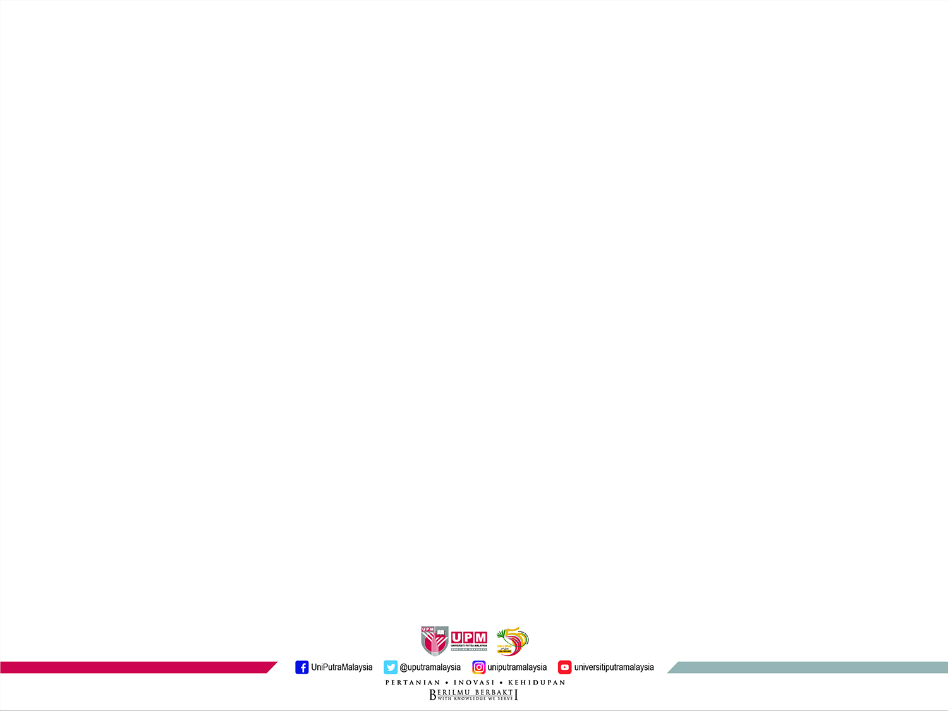
Learning Objectives
Define the following key terms:
Data, database, and Database Management System (DBMS), metadata.
Describe the advantages of using the database approach
Describe the components of database approach

Slide 3
Introduction
Every organization has huge amount of data that needs to be stored and accessed by multiple users from any location at any time.
Data is often collected and used to support a wide range of activities such as data management and data analysis.
Some examples of how databases are used include:
storing student records in an educational institution,
storing financial transactions in an accounting system,
storing inventory and orders in an e-commerce system,
storing patient records in a healthcare system, and
storing customer information in a customer relationship management (CRM) system.

Slide 4
Introduction
The amount of data generated, stored, and processed is growing tremendously.
As more of the world becomes digital and products become smarter, the amount of data that needs to be generated, stored, and processed will continue to grow.
The availability of this data also opens opportunities to leverage it for various purposes.
It gives the power to support business strategies and customer service questions as soon as possible.
A recent study by IBM shows that one of the top priorities for CEOs in the coming years is the ability to use insights and intelligence that can be gleaned from data for competitive advantage.

Slide 5
Innovation from the availability of large amount of data
Some examples from a variety of domains:
Airlines: Track if a high-value customer is experiencing a delay in a trip, where and when the customer arrives at the airport, and the gate the customer must go to make the next connection.
Fast food chain: The menu displays items that can be served quickly if the lines are long. If the lines are short, the menu displays items that are higher margins but are slower to prepare.
Online shopping: Recommend items based on the customers’ buying behavior.
The essence of the above examples is the ability to collect, organize and manage data.

Slide 6
Database
Databases are used to store, manipulate and retrieve data in mostly every type of organization: business, health care, education, government and libraries.
Database technology can be used by an individual up to large number of users accessing databases.
From personal computers to enterprise-wide distributed applications.
It can be accessed by users and remote users through diverse technologies such as ATM, Web browsers, smartphones and office environment

Slide 7
Database Management System
Database Management System (DBMS) is one of the most powerful software/tools that can be used in building business database applications.
Provide many features that represent significant advantages over traditional programming methods.
Understanding the concepts of database design, queries, and application building will reduce the time for developing complex applications.

Slide 8
Basic Concept and Definition
Data
Stored representation of objects and events that have meaning and importance in the user’s environment. Structured data or unstructured/multimedia data.
01
Database
Metadata
02
04
Data that describes the properties and context of user data.
A collection of data stored in a standardized format; designed to be shared by multiple users. It may be of any size and complexity.
03
Information
Data that have been processed in such a way as to increase the knowledge of the person who uses the data. Databases today may contain either data or information.

Slide 9

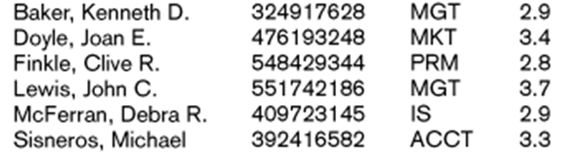
Example of Data

Slide 10
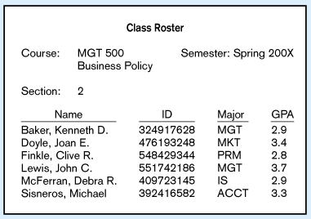
Converting Data into Information
Context helps users understand data
assign meaning to data

Slide 11
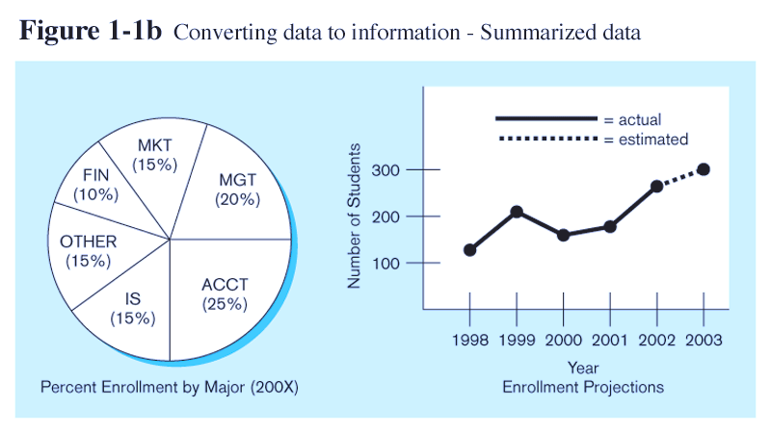
Converting data into graphical display
Graphical displays turn data into useful information that managers can use for decision-making and interpretation.

Slide 12
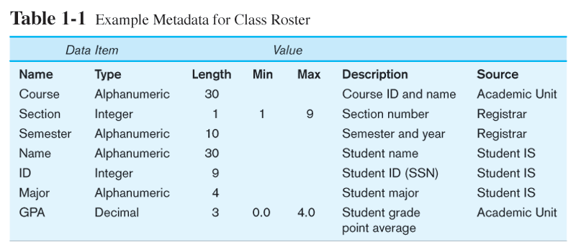
Example of metadata
Descriptions of the properties or characteristics of the data, including data types, field sizes, allowable values, and data context.

Slide 13
Traditional File Processing System
In early computer applications (early 1980s), the traditional file processing approach was commonly used.
This approach design the data processing to meet individual department rather than the whole organization.
A file is a collection of related records.
In file processing system, major data files are associated with each application, and it is typical there is duplication of some files used by applications.

Slide 14
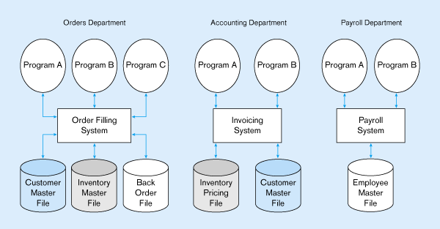
Illustration of Traditional File Processing System

Slide 15
Drawbacks of Traditional File Processing System
6
2
4
Excessive program maintenance
Duplication of data
Limited data sharing
1
3
5
Program-data dependence
Inconsistent data
Lengthy development time

Slide 16
Illustration of Program-data Dependence

Slide 17
Illustration of Program-data Dependence
Add to file (e.g., Cell phone)
Write code to copy the employee file and add an empty cell phone slot.
Find all programs that use the employee file.
Modify file definitions.
Modify reports (as needed)
Recompile, and fix new bugs.
Easy to keep to employee files?

Slide 18
Problem with Program-Data Dependence
The file description is stored within each application program that accesses a given file.
Consequently, any changes to a file structure require modifications to the file description for all programs that access the file.
It is often challenging to locate all programs affected by such changes, and consequently, errors are often introduced when making such changes.
Each application program must have its own processing routines for reading, inserting, updating, and deleting data.
Lack of coordination and central control.

Slide 19
Duplication in File Processing System
Duplicate Data

Slide 20
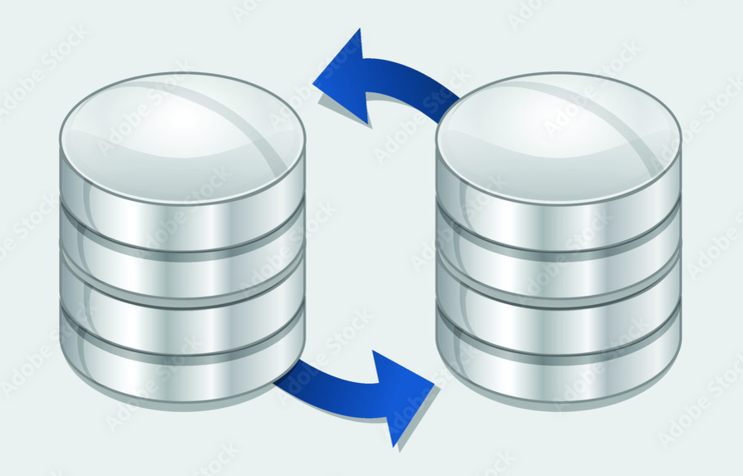
Problems with Data Redundancy
Waste of space to have duplicate data
Causes more maintenance headaches
The biggest problem:
When data changes in one file, it could cause inconsistencies
Compromises data integrity.

Slide 21
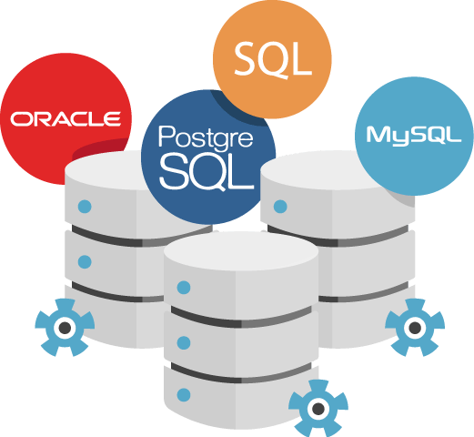
The Database Approach
A central repository of shared data.
Data is managed by a controlling agent.
Stored in a standardized, convenient form.
Therefore, it requires a Database Management System (DBMS)

Slide 22
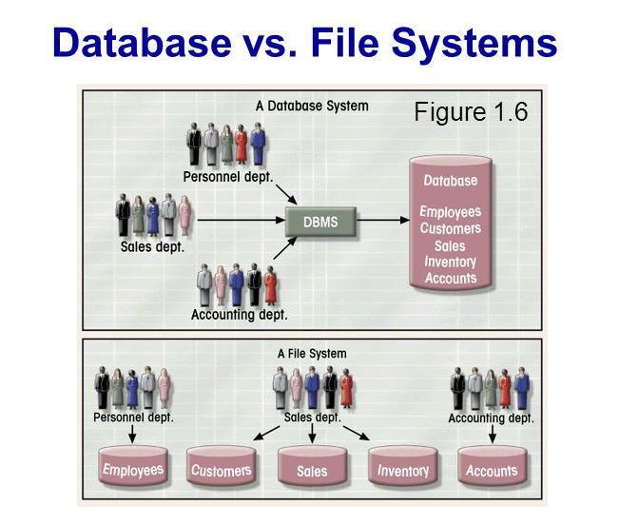
Illustration Database vs. File Processing System

Slide 23
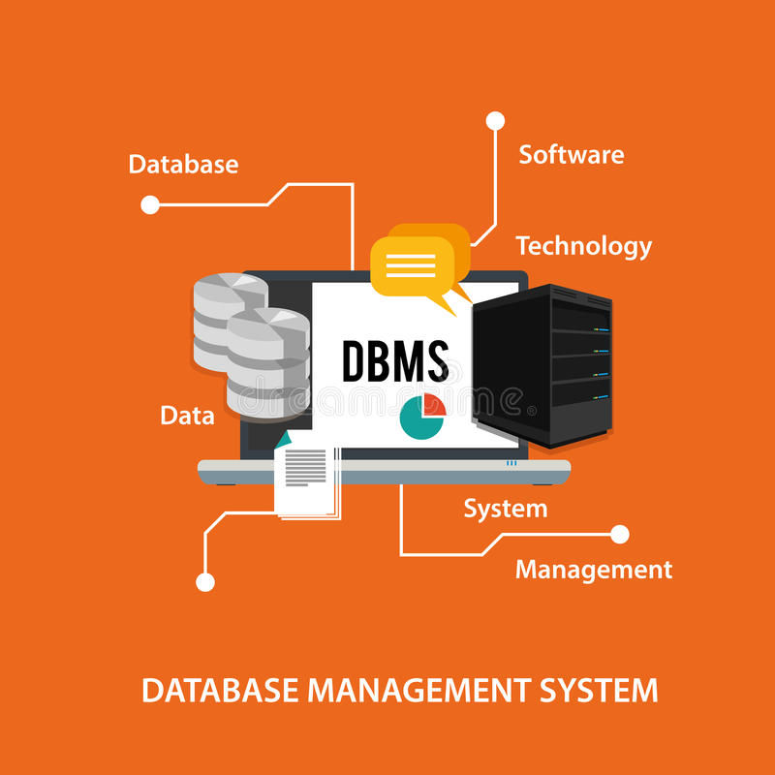
Database Management System (DBMS)
A software system is used to create, maintain, and provide controlled access to user databases.
It provides a systematic method of creating, updating, storing, and retrieving data in a database.
It enables end users and application programmers to share data, and it enables data to be shared among multiple applications rather than propagated and stored in new files for every new application.
It also provides facilities for controlling data access, enforcing data integrity, managing concurrency control, and restoring a database.

Slide 24
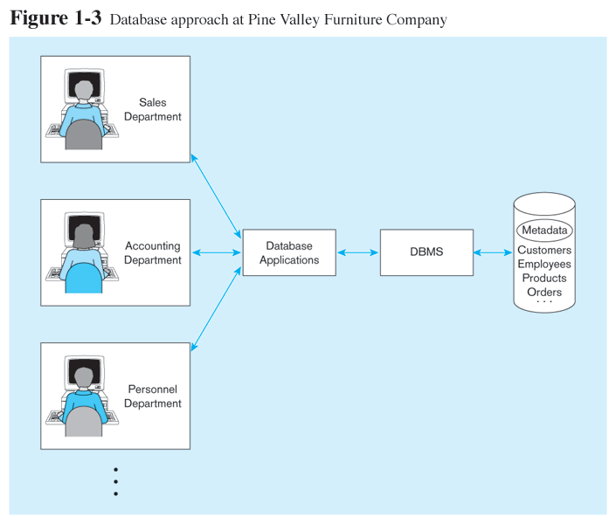
Database Management System (DBMS)
It provides an interface between the various database applications for organizational users and the database.
It allows users to share data and query, access, and update the stored data.

Slide 25
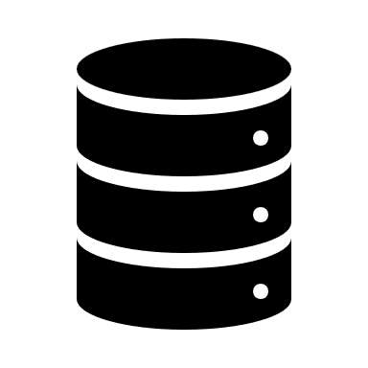
Elements of Database Approach
1. Data Model
3.Use of Internet Technology
Graphical model showing high-level entities and relationships for the organization.
Networks and telecommunications, distributed databases, client-server and 3-tier architectures.
2. Relational Database
4. Database Application
Database technology involving tables (relations) representing entities and primary/foreign keys representing relationships.
Application programs used to perform database activities (create, read, update, and delete) for database users.

Slide 26
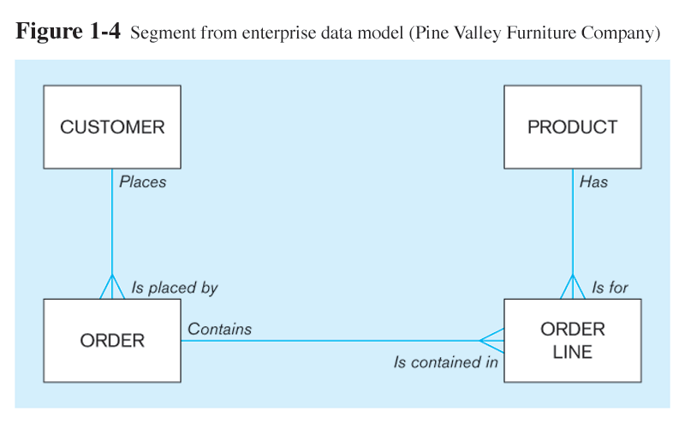
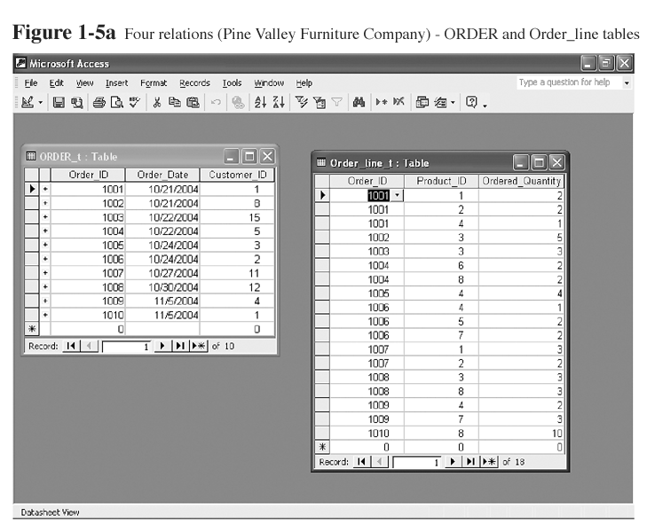
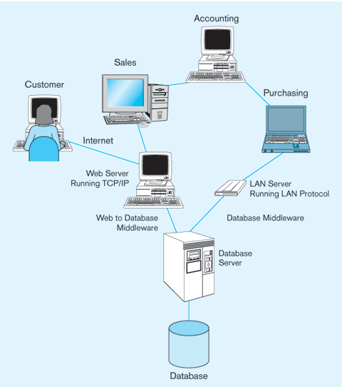
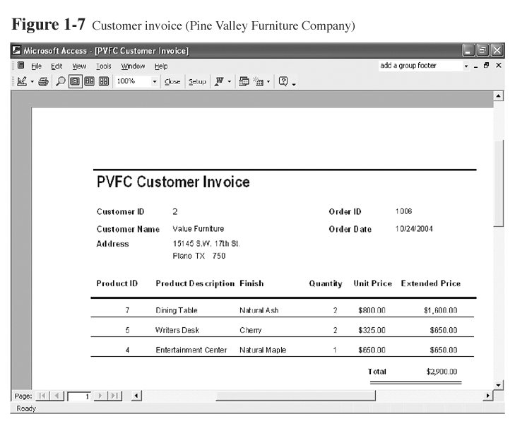
Elements of Database Approach
1. Data Model
2. Relational Database
3.Use of Internet Technology
4. Database Application

Slide 27
The Range of Database Application
The range of database applications can be divided into three categories based on the client's location (i.e., application) and the database software itself.
The categories are:
Personal Database
Two-tier Client-Server Database
Multitier Client-Server Database

Slide 28
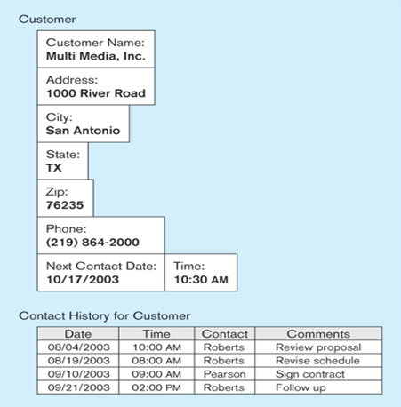
Personal Database
It is designed to support one user.
It resided on a personal computer, including laptops, smartphones, and PDAs.
The purpose of this kind of database is to provide the user with the ability to manage a small amount of data efficiently.

Slide 29
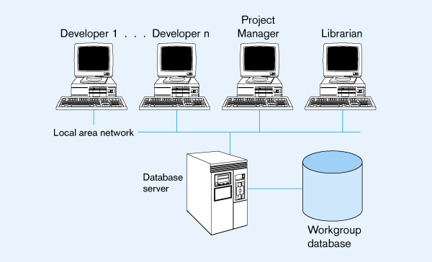
Two-Tier Client-Server Database
A relatively small team of people collaborated on the project that required a shared database amongst the group.
The most common method of sharing data for this type of need is a two-tier client-server application.
In this method, the client manages the main business and data processing logic and user interface.
While the server manages and controls access to the database.

Slide 30
Multitier Client-Server Database
The emergence of the Web changed the roles of client and server, leading to the three-tier architecture.
Three-tier architecture can enhance security:
Database server only accessible via a middle tier
Clients cannot directly access the database server
In three-tier architecture:
User interface layer – runs on the client.
Business logic and data processing layer – middle tier runs on a server (application or web server).
DBMS – stores data required by the middle tier. This tier may be on a separate server (database server).
If the bottom layer is split into two layers (a web server and a database server), then it is a 4-tier architecture (possible to the n-tier)

Slide 31
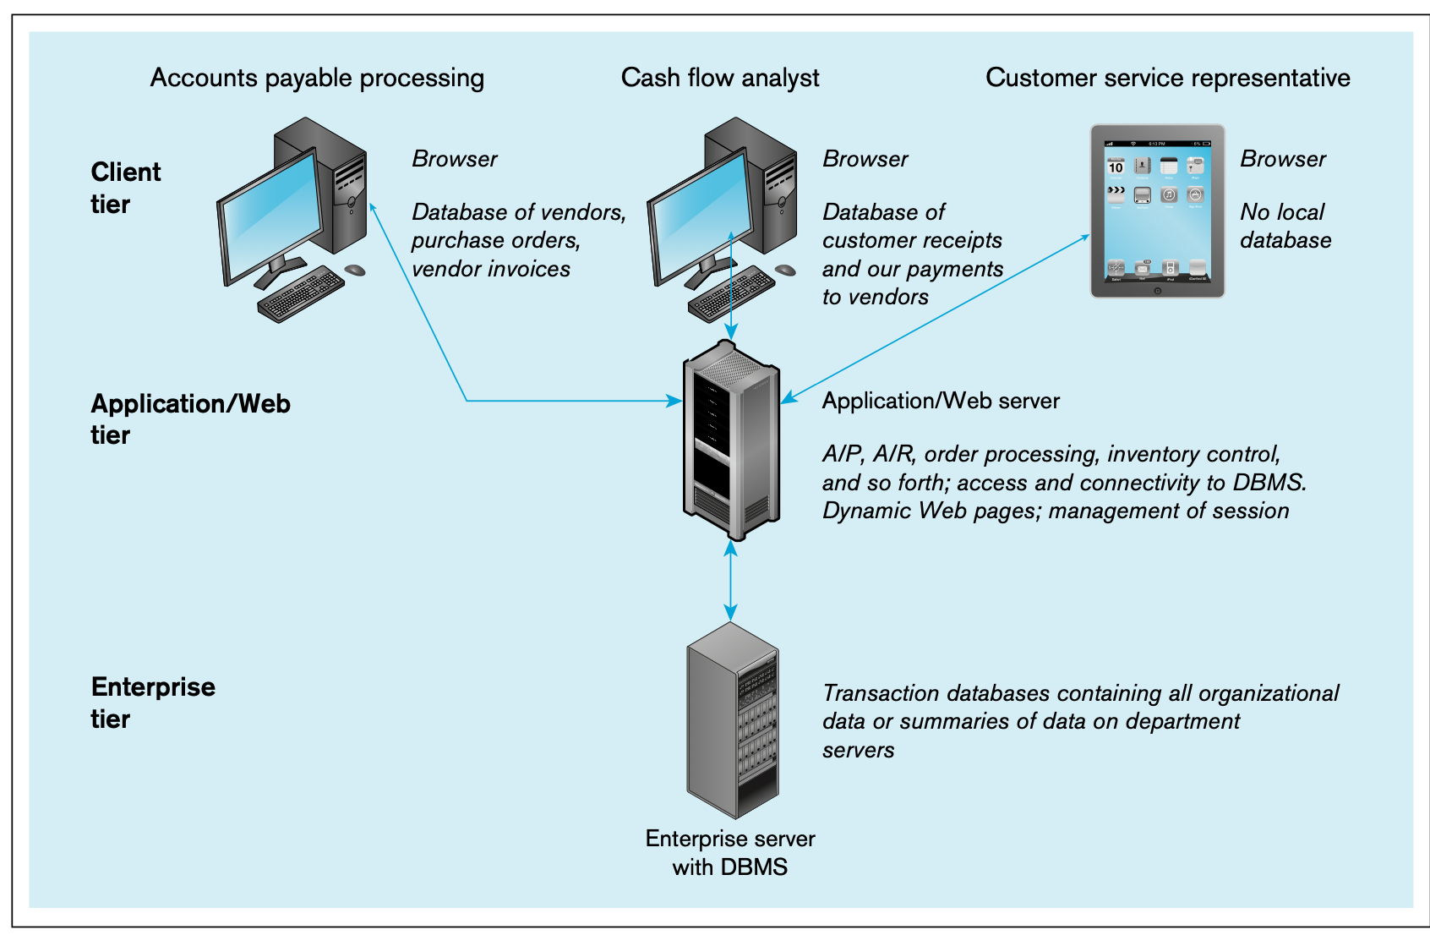
Illustration of Three-tier Client-Server Database

Slide 32
The advantages of the database approach

Slide 33
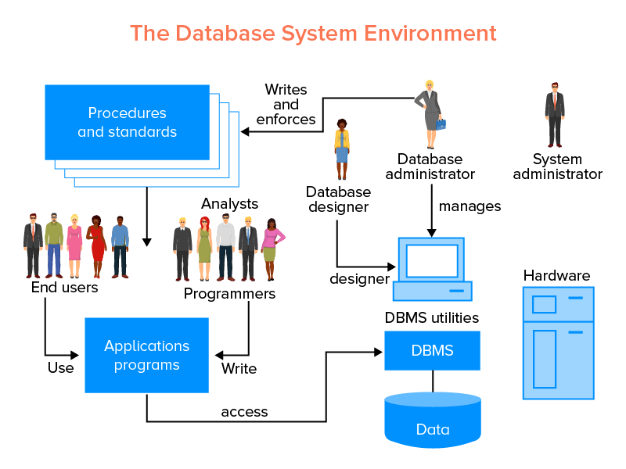
The Database System Environment
Hardware
Software
People

Slide 34
The Database System Environment
Data modeling and design tools – automated tools used to design databases and applications programs.
Repository – centralized storehouse of metadata
Database Management System (DBMS) – software for managing the database
Database – a storehouse of the data
Application Programs – software using the data
User Interface – languages, menus, and other facilities by which users interact with various system components such as CASE tools, DBMS, etc.
Data/Database Administrators – personnel responsible for maintaining the database
System Developers – personnel responsible for designing databases and software
End Users – people who use the applications and databases.

Slide 35
Example of Commercial DBMS (Relational)
Oracle
Postgres
Informix (Unix)
DB2, SQL/DS (IBM)
Access (Microsoft)
SQL Server (Microsoft +)
Many older (Focus, IMS, ...)
Many limited PC (dBASE, Paradox, …)

Slide 36
Evolution of Database Systems
Flat files - 1960s - 1980s
Hierarchical – 1970s - 1990s
Network – 1970s - 1990s
Relational – 1980s - present
Object-oriented – 1990s - present
Object-relational – 1990s - present
Data warehousing – 1980s - present
Web-enabled – 1990s - present

Slide 37
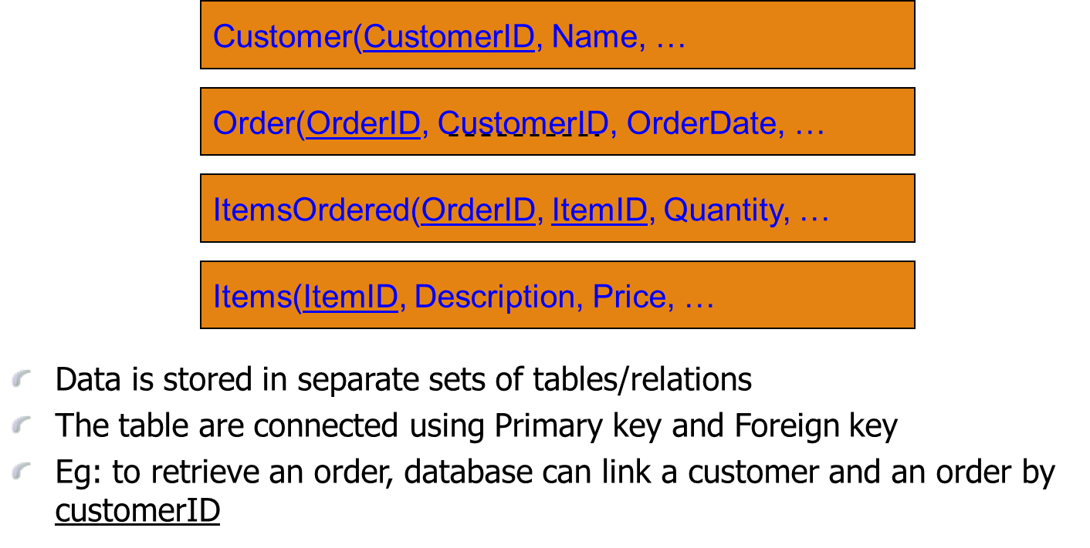
Relational Database

Slide 38
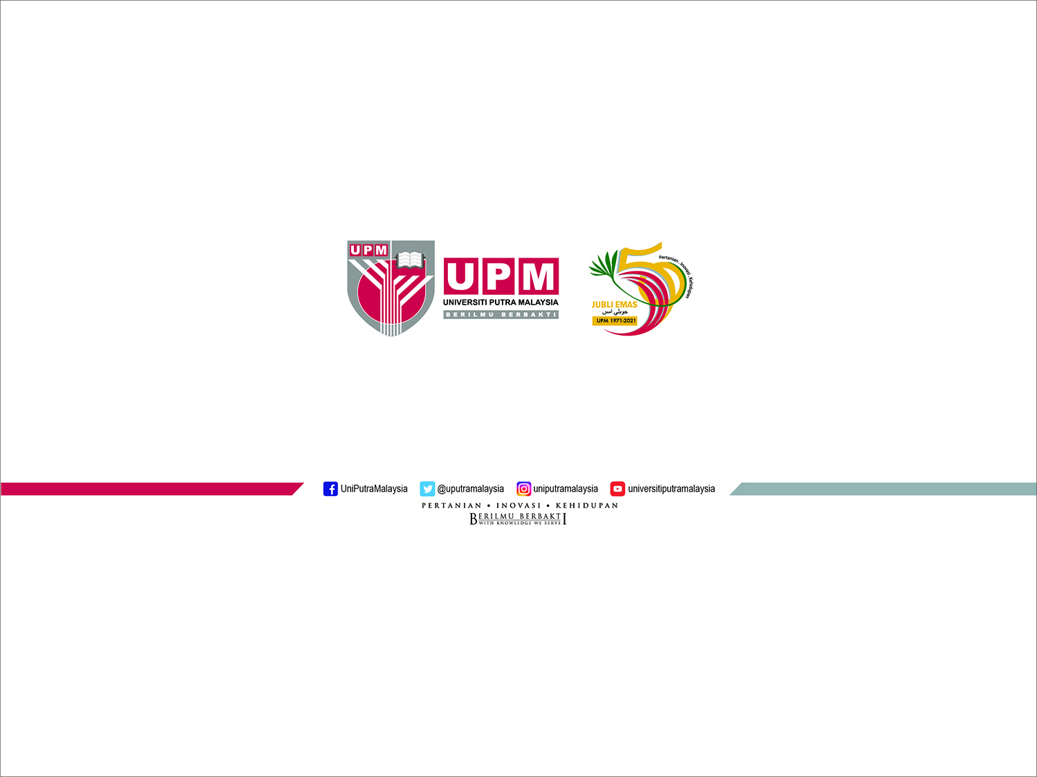
End of Chapter

